Slide 1
Class presentation for course 236818 – Seminar in Bioinformatics, Spring 2005
“An efficient algorithm for detecting frequent subgraphs in biological networks”
Authors: Mehmet Koyuturk, Ananth Grama and Wojciech Szpankowski
Presented by: Talya Gendler

Slide 2
Contents:
Introduction
Motivation
Defining metabolic pathways and their graph representation
The Algorithm itself
An example
Results

Slide 3
Introduction
We are going to talk about biological networks, and to be more specific, about metabolic pathways.
Q: What do we want to do?
A: Find frequent subgraphs in metabolic pathways, or in other words, mine metabolic pathways in order to discover common motifs of enzyme interactions that are related to each other.
gltX
nadE
For example:
glnA
guaA
glmS
purF

Slide 4
Motivation
A quick reminder:
Metabolic pathways have important biological meanings.
Metabolic pathways are evolutionary conserved.
They are the bridge between understanding single molecules (enzymes, proteins etc.) and understanding the cell’s function as a whole.
What we can learn:
  Common motifs of cellular interactions
  Evolutionary relationships
  Organization of functional modules

Slide 5
Introduction – cont.
We want to find functional modules, and these can be expected to be repeated among several pathways/organisms.
Biological networks are often modeled as some sort of graphs.
In our case, metabolic pathways may be represented as graphs, where nodes represent compounds (substrates and products) and edges represent enzymes (reactions).
This model can be reduced to a directed graph with nodes for enzymes, and a directed edge from one to another to imply that the second consumes a product of the first.

Slide 6
One approach: define the problem as finding isomorphic substructures (independent of labeling). Here we focus on the structure of relationships between entities. This is computationally hard, since the subgraph isomorphism problem needs to be solved at each step (and that is NP-complete).
Our approach: We define the problem as one of finding frequent patterns that have both the entities (node labels) and the relationships between them (graph structure) in common.
Obviously, this makes “biological” sense
  We are interested in common relationships between biomolecules.
As well as simplifying our problem ☺

Slide 7
We represent each enzyme by a unique node, independent of the number of times the enzyme appears in the underlying pathway.
This restriction simplifies the graph mining problem significantly while providing results that are biologically meaningful.
Moreover, this simplification does not cause any loss of information and the model can be easily reverted to capture more detailed information on pathways once frequent subgraphs are discovered.

Slide 8


Graph formalism for metabolic pathways
Definition 1
A metabolic pathway P(M ,Z ,R) is a collection of metabolites M, enzymes Z, and reactions R, where each reaction r R is associated with a set of enzymes Z(r) Z, a set of substrates S(r) M, and a set of products T (r) M.
S(r)
Z(r)
T(r)

Slide 9










Graph formalism – cont.
Definition 2
Given metabolic pathway P(M ,Z , R), the associated directed graph G(V , E) of P is constructed as follows:
for any enzyme , there is a node . There is
an edge from to , i.e. ( , ) E if and only if
, R, such that Z(r1), Z(r2), and T (r1) ∩ S (r2) ≠ ∅.
This means that there exists a directed edge from one enzyme to another the second enzyme consumes a product of the first one.

Slide 10
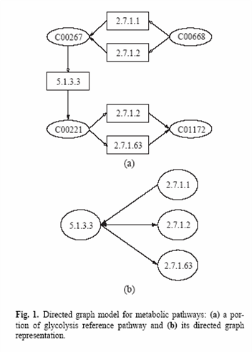
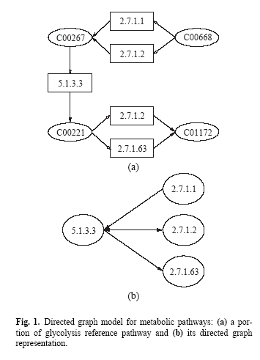
Enzyme appears twice
Once

Slide 11
Graph formalism – cont.
Definition 3
Given a collection of graphs G1, G2, … , Gn and support threshold ε, the Maximal Frequent Subgraph Discovery problem is one of finding all maximal connected subgraphs that are contained in at least εn of the input graphs.
This defines support – the support of a subgraph that is contained by n’ of the graphs is n’\n. A subgraph is frequent if it’s support is greater than ε.

Slide 12

Graph formalism – cont.
Maximality of discovered subgraphs is enforced in order to avoid redundancy. We say that a frequent subgraph is maximal if it is not contained by another frequent subgraph, i.e. its edgeset is not a subset of edges of any other frequent subgraph.
Since a node label cannot be repeated in our directed graph model, every edge that may exist in a graph is uniquely specified by the labels of its incident nodes.
Therefore, we can represent a connected subgraph by a set of edges. Following is the concept of a connected edgeset:
Definition 4 – A unique edge e is a set of two node labels vi , vj. A set of unique edges ES = {e1, e2, … , ek} is called a connected edgeset if and only if all edges in the set are connected, i.e. any subset ES’ ES shares at least one node with the remaining set of edges ES\ES’.

Slide 13
Let’s talk about the algorithm
Existing graph mining algorithms are generally based on frequent itemset mining, which is a well studied problem.
The fundamental approach is to construct frequent itemsets from smaller to larger sets, based on the fact that any subset of a frequent itemset must be frequent in itself. Of course, this is true also for edgesets in our model.
➔ Enumerating all itemsets in a bottom-up fashion provides efficient pruning of the search space, since most large sets are eliminated without consideration.
What does this mean?

Slide 14
Since we are only interested in connected subgraphs, it is more efficient to consider only connected edgesets in the search process.
It is also necessary to avoid redundancy which may occur by considering the same set of edges more than once in a different order.
How do we do this?
We develop a depth-first enumeration algorithm based on backtracking. This algorithm extends each subgraph only with edges from a candidate edgeset. It maintains connectivity by adding edges that are connected to the current subgraph, and avoids redundancy by keeping track of already visited edges.
Why depth first? Because we want to save memory. Provided sufficient memory, breadth-first algorithms are faster.

Slide 15

The Algorithm!!!
Procedure MinePathways (MFS,Ek,Ck,D)
  MFS: Set of maximal frequent subgraphs
  Ek: Frequent subgraph with k edges
  Ck: Set of candidate edges
  D: Set of already visited edges
ismaximal ← true
for all edges ei Ck do
  D ← D U {ei}
  Ek+1 ← Ek U {ei}
  If Ek+1 is frequent then
    ismaximal ← false
    Ck+1 ← (Ck U N(ei))\D
    MinePathways (MFS,Ek+1,Ck+1,D)
if ismaximal then
  If Ek has no superset in MFS then
    MFS ← MFS U Ek

Slide 16
The Algorithm – cont.
The procedure is invoked for each edge ei that is frequent in the collection of graphs. It is invoked as:
MinePathways(MFS,{ei},N(ei),{e1,e2,…,ei-1})
where N(ei) denotes the neighbours of ei (only the frequent ones). MFS is empty at the first invocation, and is input to the procedure at each subsequent invocation.
In each invocation, the algorithm tries to extend the edgeset (subgraph) by all edges in the candidate set. If the extended one is frequent, it is invoked again for the extended subgraph. It stops when an edgeset cannot be extended any further. If it is not contained by another frequent edgeset, it is recorded (saved in MFS).

Slide 17
An example
a
b
a
b
Looking for subgraphs that exist in at least three of the input graphs.
c
c
e
d
e
d
Graph G1
Graph G2
The procedure will be invoked for:
ab
ac
de
a
b
a
b
c
c
e
d
e
d
Graph G3
Graph G4

Slide 18
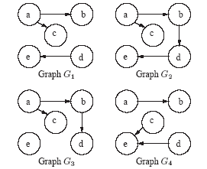
Resulting enumeration tree:
Candidate set is
N(ab) = {ac}
Ø (∞)
{ab} (4)
{ac} (3)
{de} (3)
{ab,ac} (3)
Not checking extension with ab because it was already visited
Edgeset {ab,ac} is frequent

Slide 19
The Algorithm!!!
Procedure MinePathways (MFS,Ek,Ck,D)
  MFS: Set of maximal frequent subgraphs
  Ek: Frequent subgraph with k edges
  Ck: Set of candidate edges
  D: Set of already visited edges
ismaximal ← true
for all edges ei Ck do
  D ← D U {ei}
  Ek+1 ← Ek U {ei}
  If Ek+1 is frequent then
    ismaximal ← false
    Ck+1 ← (Ck U N(ei))\D
    MinePathways (MFS,Ek+1,Ck+1,D)
if ismaximal then
  If Ek has no superset in MFS then
    MFS ← MFS U Ek

Slide 20
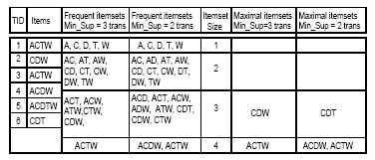
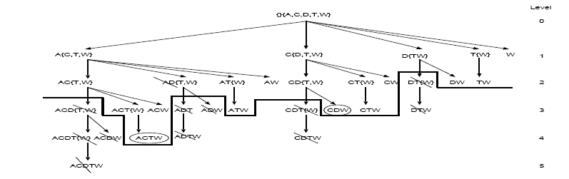
Pruning…
Enumerating all itemsets in a bottom-up fashion provides efficient pruning of the search space, since most large sets are eliminated without consideration.
Support=3

Slide 21
Results
Following is a discussion of the results received from using this algorithm to mine several pathway collections, extracted from the KEGG metabolic pathway database.
By the end of 2003, KEGG contained pathway maps of several metabolic processes for 157 organisms.
(and now has ~ 300 )

Slide 22
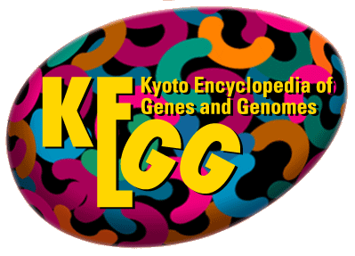
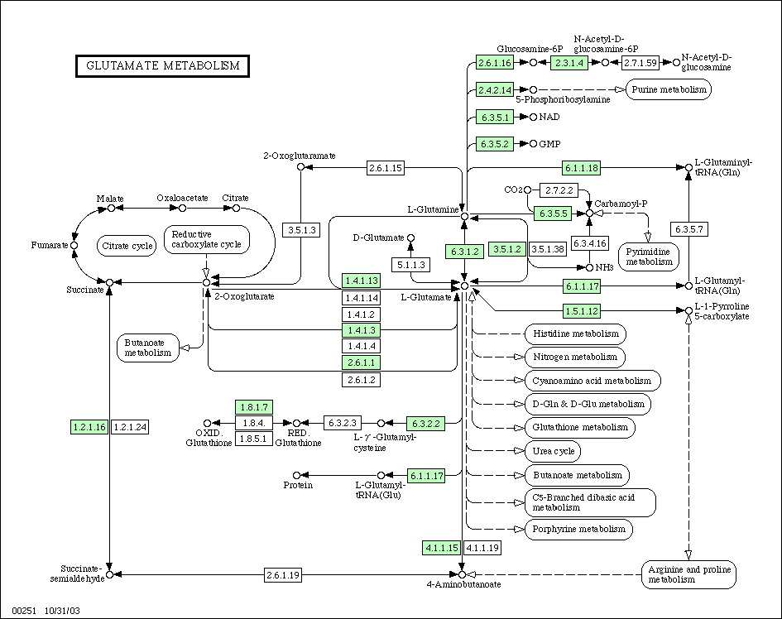
KEGG

Slide 23
Results – cont.
gltX
nadE
The bold edges & nodes are a frequent sub-pathway in 45 (29%) of the organisms.
glnA
guaA
Reducing the support threshold to 19.3% (30 organisms), we receive the following graph. As you can see, it is indeed a supergraph of the previous one.
glmS
purF
Frequent sub-pathways discovered for different support values on glutamate metabolism among 155 organisms.
And further reducing it to 14.2% (22 organisms)
Self loop – two consecutive reactions

Slide 24
Results – cont.
nadB
pyrB
32.1% - 50 organisms
aspS
argG
19.2% - 30 organisms
11.5% - 18 organisms
purA
argH
Appears in the most frequent but is excluded from the larger graph of lower frequency
purB
Frequent sub-pathways discovered for different support values on alanine–aspartate metabolism among 157 organisms.

Slide 25
Results – cont.
argG
argG
argG
argG
argG
argG
argG
Frequent sub-pathways discovered for different support values on pyrimidine metabolism among 156 organisms.

Slide 26
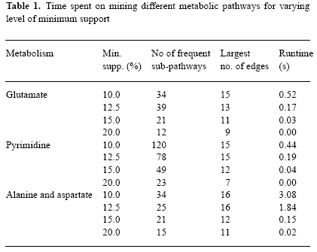
How quick is the algorithm?
Lower thresholds take longer to find
How big is our data space?
  Glutamate pathway collection has a total of 2804 nodes and 11,339 edges over 155 organisms.
  Alanine–Aspartate - 2681 nodes, 8481 edges, 156 organisms.
  Pyrimidine - 3375 nodes, 7218 edges, 156 organisms.
Not bad…
Pentium IV 2.0 GHz, 512 MB RAM
Conclusion: the algorithm provides near-time response for practically interesting queries

Slide 27
Possible Improvements:
Adding flexibility for capturing biologically meaningful information.
Investigation of probabilistic models and metrics to help evaluate the significance of discovered patterns.
Extending the notion of a matching subgraph to the notion of an “approximate” match. We would have to formalize the notions of approximations and distance.

Slide 28
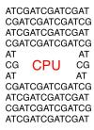
Thank You!

